Slide 1
Visual
Data
Presentation
Part II
© McGraw Hill LLC. All rights reserved. No reproduction or distribution without the prior written consent of McGraw Hill LLC.

Slide 2

“Lord, Lord, how this world is given to lying.”
- W. Shakespeare (Henry IV)

Slide 3
Breaking the Rules
You will follow rules for good graphs. But not everyone does.
It's time to learn some self-defense.

Slide 4
Avoiding Deception
Know types of graphs and when to use them.
Learn and apply rules of good graphing
Practice and improve your skills.
Learn deceptions that you may encounter.
Be critical of unclear or deceptive graphs.

Slide 5
Non-Zero Origin
A non-zero origin on the Y-axis exaggerates taller bars relative to shorter ones.
Measured bar height does not match the stated values or axis demarcations.
Tip: Unless there is an axis scale, you will need a ruler to detect this distortion.

Slide 6
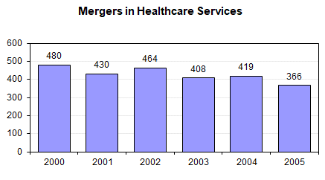
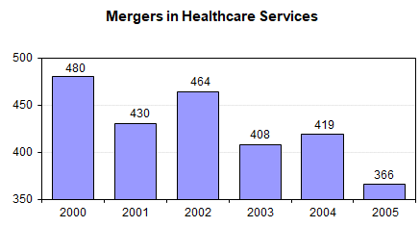
Non-Zero Origin
Zero Origin
Bar heights are in correct proportions.
Non-Zero Origin
2005 looks like 15% of 2000. The correct ratio is 76% (i.e., 366/480).
Source: Modern Healthcare, By the Numbers, Dec. 19, 2005, p. 10.

Slide 7
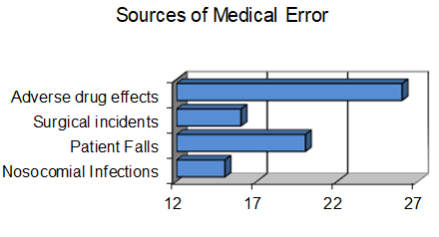
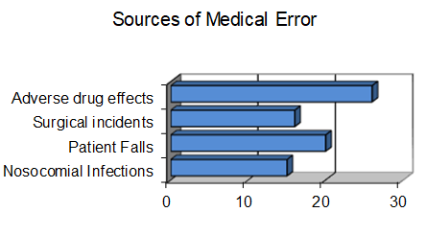
Non-Zero Origin
Incorrect
First graph makes it appear that adverse drug effects occur four times as often as nosocomial infections.
Correct
Second graph shows that their true ratio is less than 2 to 1.

Slide 8
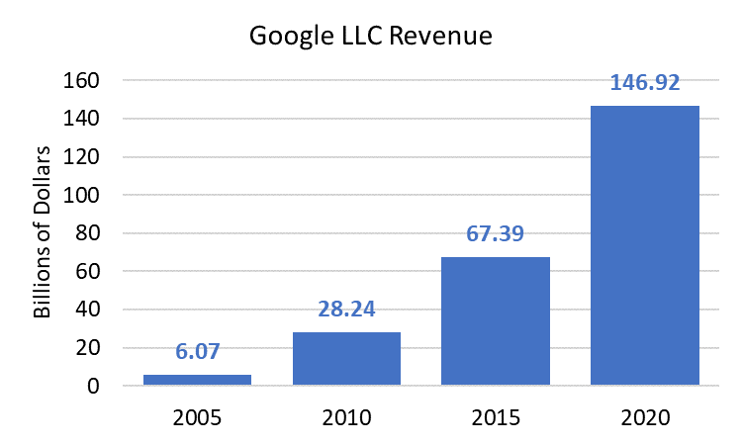
Zero Origin
The zero-origin rule is important in accounting (e.g., assets, revenue, profit) to portray the financial status of a company. It is illegal to mislead investors). Some scientific journals require a zero origin.
Source: Company annual reports

Slide 9


Always Zero Origin?
There are situations when a zero origin prevents effective display of the intended information, e.g., stock indexes, or when data starts far from zero.
Source: http://aolpf5.marketwatch.com/

Slide 10
Always Zero Origin?
In this example, a non-zero origin fails to display adequate detail. The second graph is clearer.

Slide 11
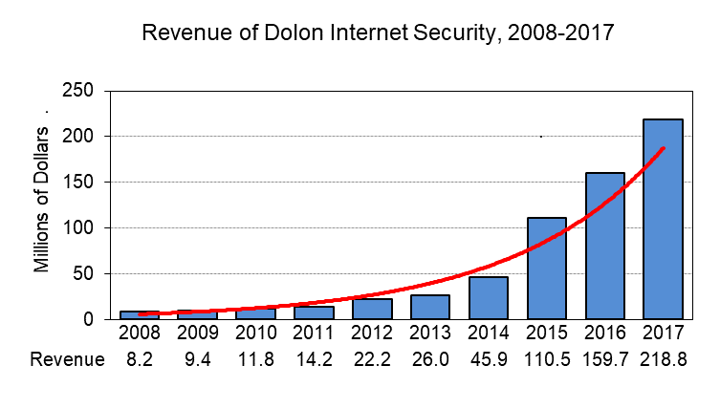
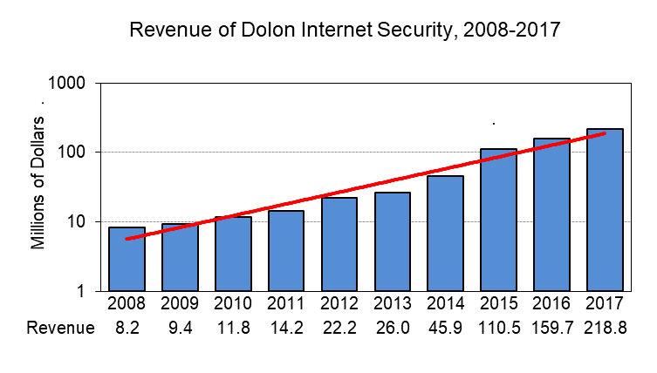
Log Scale
When data magnitude varies greatly, a log scale may be necessary.
Constant percent growth
Same data appears linear on a log scale

Slide 12

Log Scale
On a log scale equal distances show equal ratios.
Ratio
10 to 1
Ratio
10 to 1
2010
sales: 11.8
2015
sales: 110.5
110.5/11.8 ≅ 10 to 1
Tip: Many people do not understand log scales. Be prepared to explain and interpret.

Slide 13
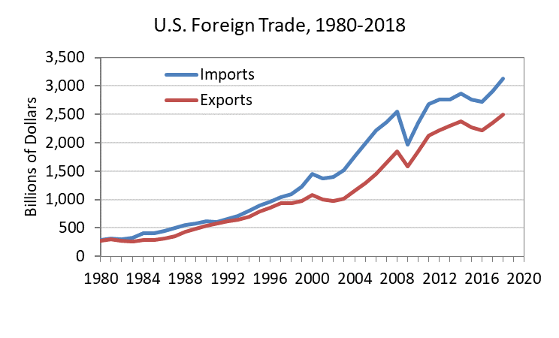
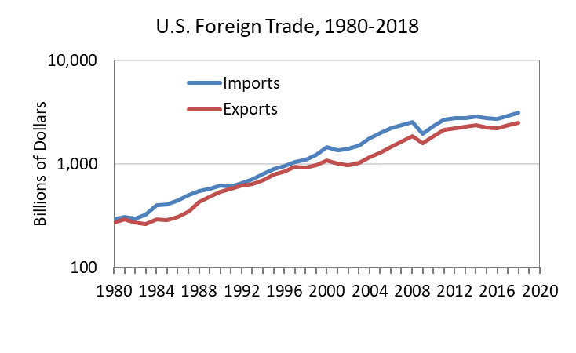
Log Scale
On a linear scale, we see that the trade deficit has increased more than linearly.
On a log scale, the percent growth rate appears constant or even declining.
Source: Economic Report of the President, 2020

Slide 14
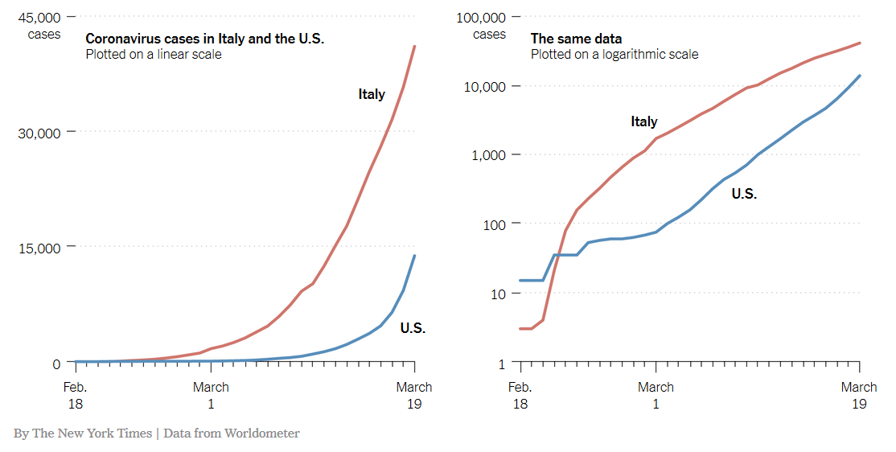
Log Scale
A log scale helps to compare rates of growth that are not obvious on an arithmetic scale.
Sources: The New York Times, 3-23-2020 and Worldometer

Slide 15
Unclear Definitions
Missing or unclear units of measurement leave the reader in limbo. Label the Y axis!
Total revenue? Profit? Profit after taxes? Number of employees?

Slide 16
Unlabeled Values
For best clarity, label each bar with its numerical value.
Tip: Bar value labels may be omitted if the scale and axis tick marks are clear (especially if a grid is used) or if you are worried about distracting attention from the data.

Slide 17

Uneven Axis Ticks
Years and axis demarcations should be at even intervals on the scale.
Uh-Oh: Where did 2017 and 2018 go?

Slide 18
Dramatic Effects
Titles that grab attention make it harder for the reader to draw an independent conclusion.
Emotional words, scary pictures and non-zero origin can bias the reader.

Slide 19

Nonzero Origin
In addition to a dramatic title, the non-zero origin and 3-D scale make med school applications seem to grow wildly. The actual increase was about 42% over 20 years.
Source: Association of American Medical Colleges (http:/www.aamc.org)

Slide 20
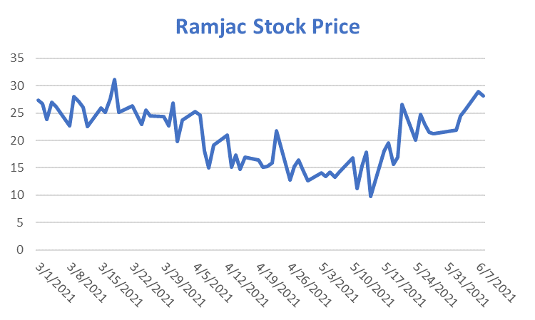
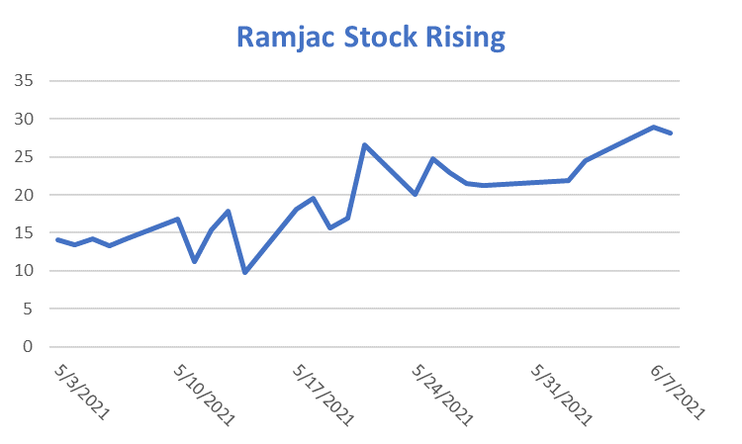
Starting Point
Selecting data to support a conclusion.
Over 35 weeks the stock price fluctuated, ending about where it started.
But for last the 5 weeks the price nearly doubled.

Slide 21
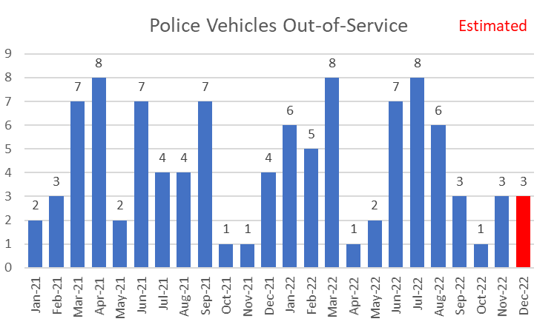
Estimated Data
When “latest” figures are unavailable, the author may estimate the most recent year (quarter, month, etc).
When one or two data points are missing, the artist is tempted to "fill in the blanks” with estimated values.
Such points can be clearly noted (e.g., different color) and be labeled “estimated”.

Slide 22
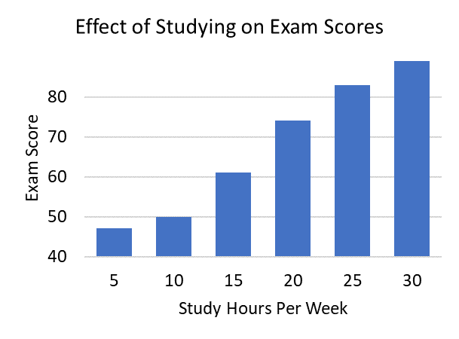

Extended Graph Trick
Data appears to “burst” through the upper scale limit.
Non-zero origin exaggerates vertical distance.
Tip: Such deceptive devices that are designed to get attention. Be on guard.

Slide 23
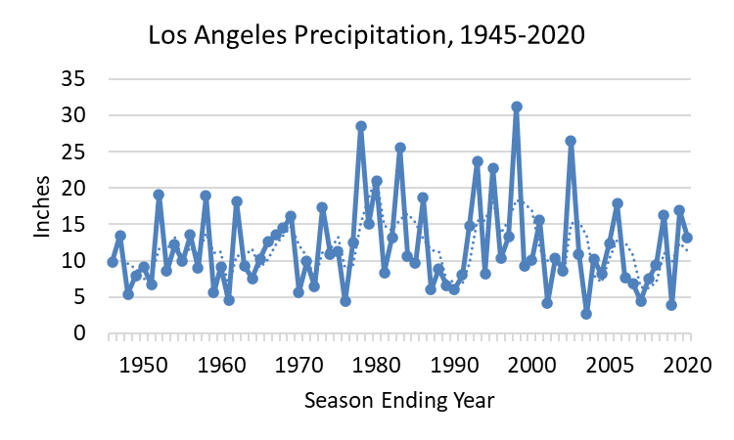
Vague Source
A vague source is useless. Large organizations issue many reports. At least give a Web link
Vague sources may indicate that the author lost the citation or mixed data from several sources.
Not specific.
Source: NOAA

Slide 24
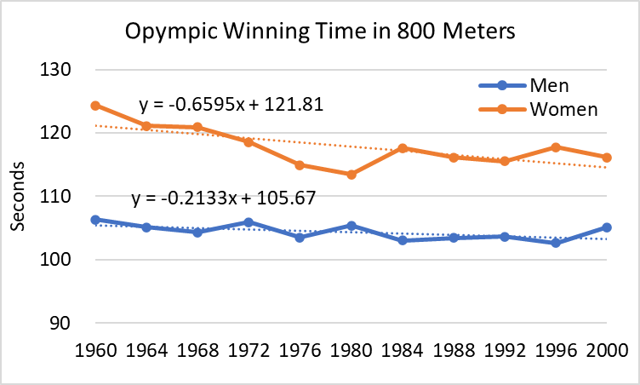
Vague Source
Source: Olympic records.
Not specific.

Slide 25

Authority Figures
Commercials and ads feature attractive actors portraying scientists, doctors, or business leaders with scientific-looking charts.
Because the public respects science, such displays impart credibility to self-serving commercial claims.
The chart shows a weight loss of only 3 pounds. Was this attributable to Zappo pills? Who knows?

Slide 26
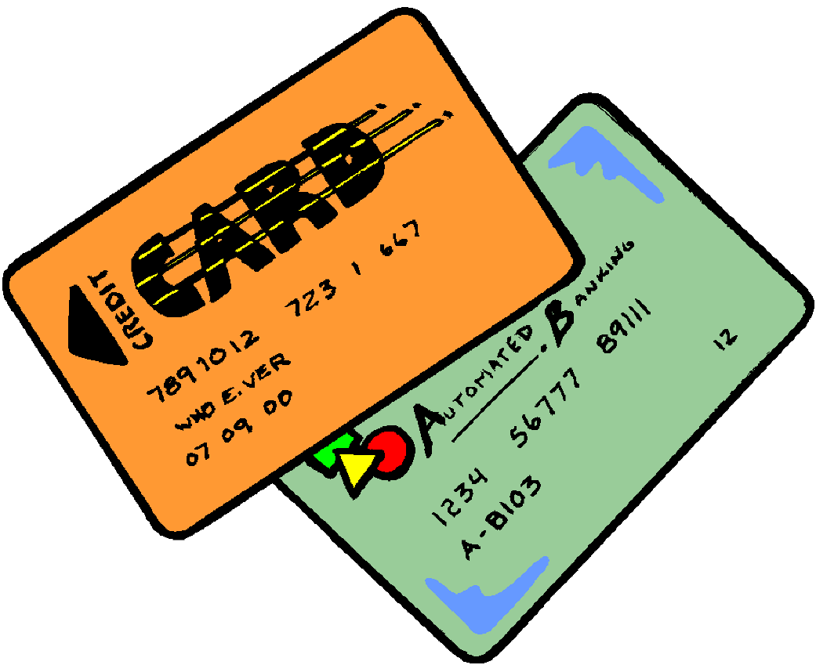
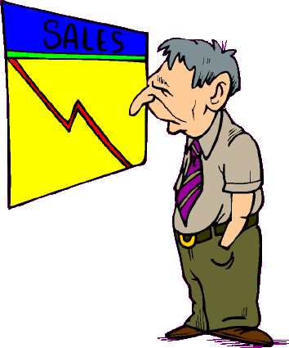

Distracting Pictures
For dramatic effect, artists may superimpose a figure or drawing on a chart. This can distract the reader or impart an emotional slant to the chart.
But debt only increased by $300 in 15 years.

Slide 27
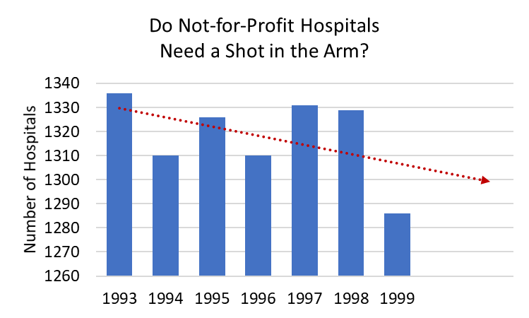
Distracting Pictures

Slide 28
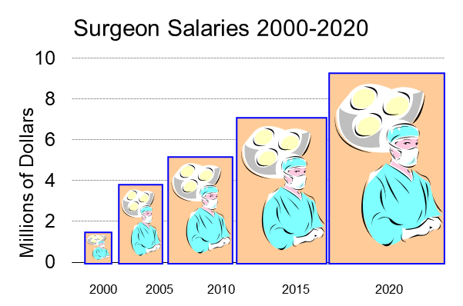
Area Trick
Bar width changes as well as bar height.
This area trick distorts the trend.
As bar height increases, so does width
This distorts the area. Pictures worsen the effect.

Slide 29
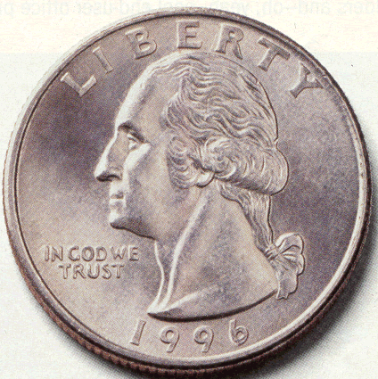
Area Trick
Both width and height change.
The large coin’s height is 3 times the small coin’s height.
But the large coin’s area is 9 times the small coin’s area.
2010
2015
2020

Slide 30
Area Trick
Increasing width as well as height exaggerates change. Visually we could fit 17 bars from 2000 inside the 2020 bar (actual increase was 5.6 times).

Slide 31

Radar Chart
Sometimes called a “spider chart.” Distorts data by showing areas instead of proportions.
Tip: Avoid this type of chart.

Slide 32
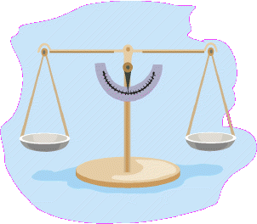
“... a lie which is half a truth is a harder matter to fight”
- A. Tennyson (1864)

